Slide 1
Opportunity Youth in
South King County
Jarod Carrol
Luis Labra
Timothy Cummins

Slide 2
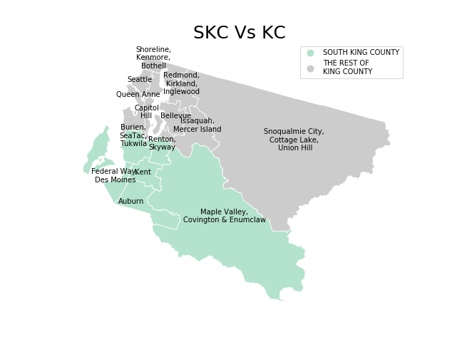
What is South King County?
South King County spans from Burien down to Auburn and all the way over to Enumclaw

Slide 3
Opportunity Youth
Opportunity Youth are individuals between the age of 16 and 24 that are not currently working or enrolled in a recognized government institution.

Slide 4
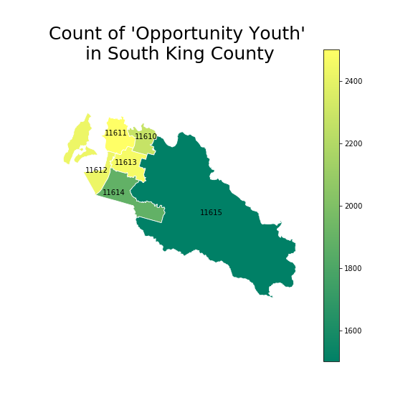
Areas with the most with Opportunity Youth
In our sorting of the Data from the 2017 American Community Survey is that there are around ___ Opportunity Youth living in South King County
By grouping SKC by the identification given to them in the Public Use Microdata Sample we can see that the highest rates of OY surround the areas just outside of Seattle
*Text on Plot: PUMA ID

Slide 5
What is the problem?
These young people are not contributing to the local economy… or any at all, costing taxpayers money to support these unmotivated and lost youth
According to the “Economic Value of Opportunity Youth” every year one of these young persons stay in the category of OY it is costing taxpayers about $13,900

Slide 6
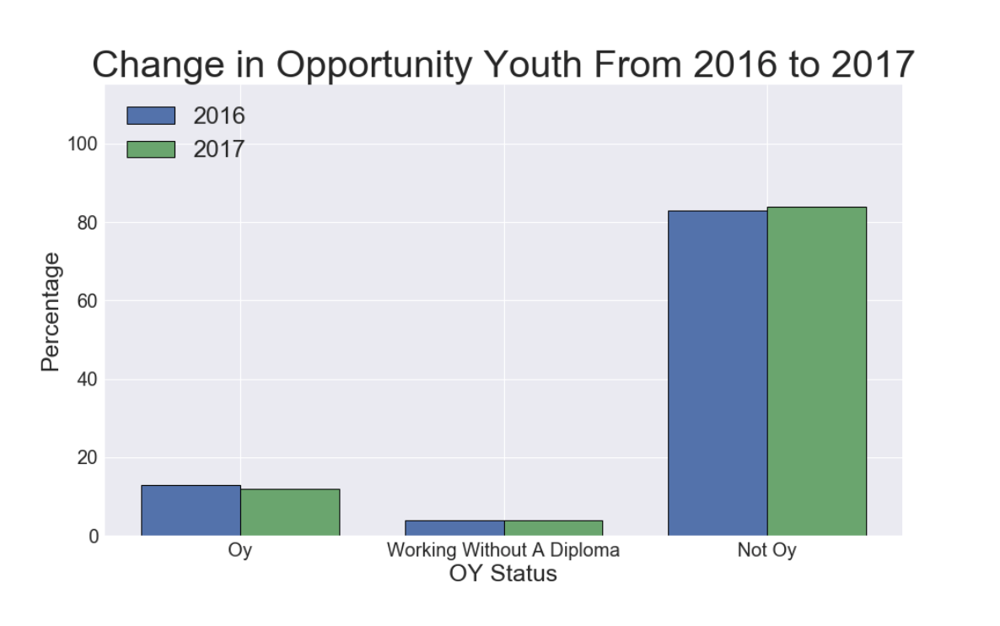
Decrease in Opportunity Youth
From last year we have a decrease in ‘Opportunity Youth’ and young people working without a diploma but what is what are these young people doing?

Slide 7
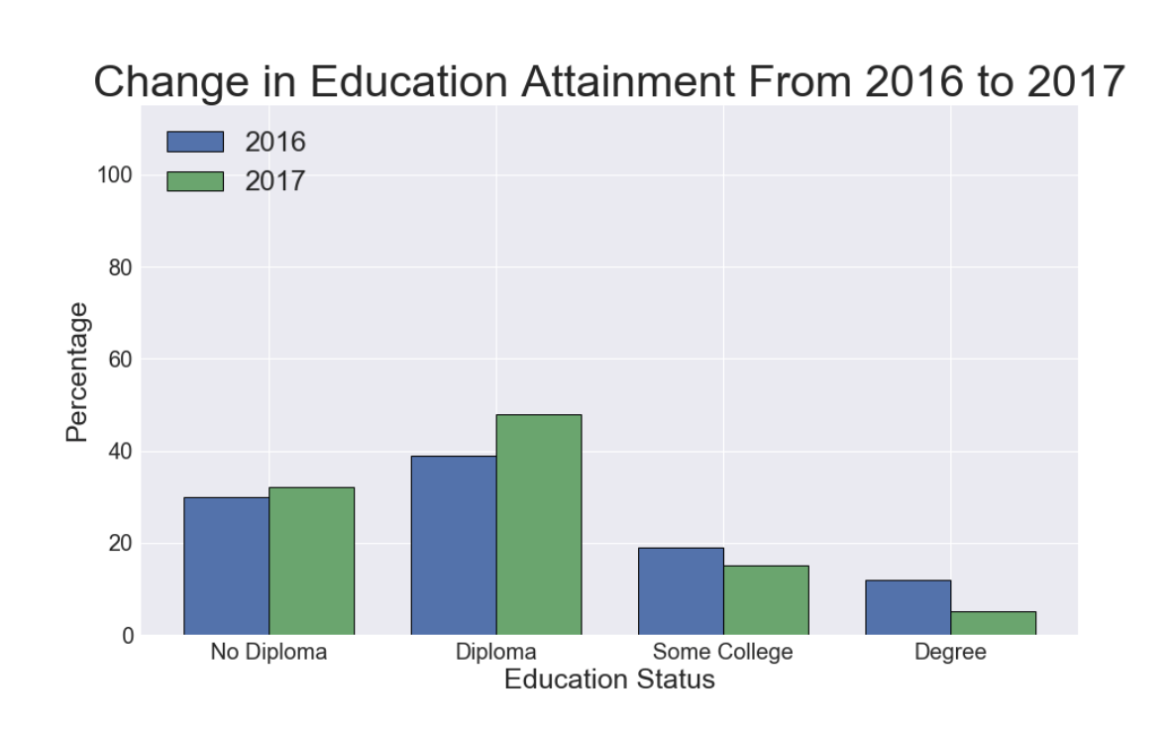
Education
Increase in youth graduating from high school
Decrease in youth seeking higher education

Slide 8
What We Have Gathered So Far
From 2016 to 2017:
Less people are seeking government accredited higher education after high school
More people are graduating from high school

Slide 9
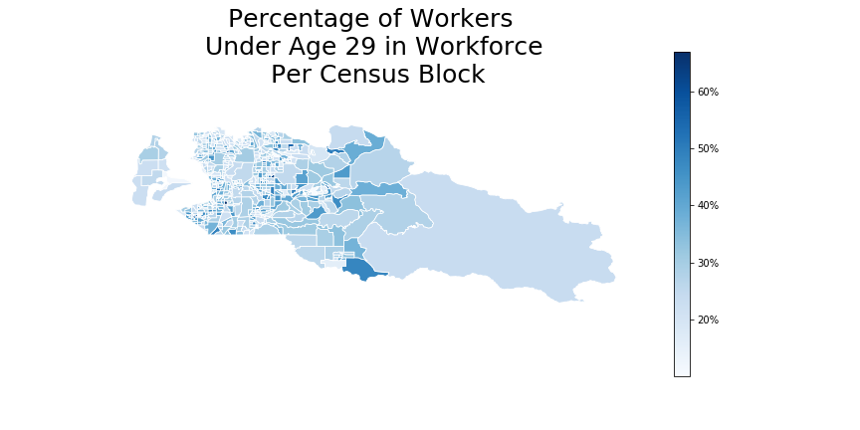
Top Industries Young Workers are going into:
Utilities
Healthcare
Other Services (Except Public Administration)

Slide 10
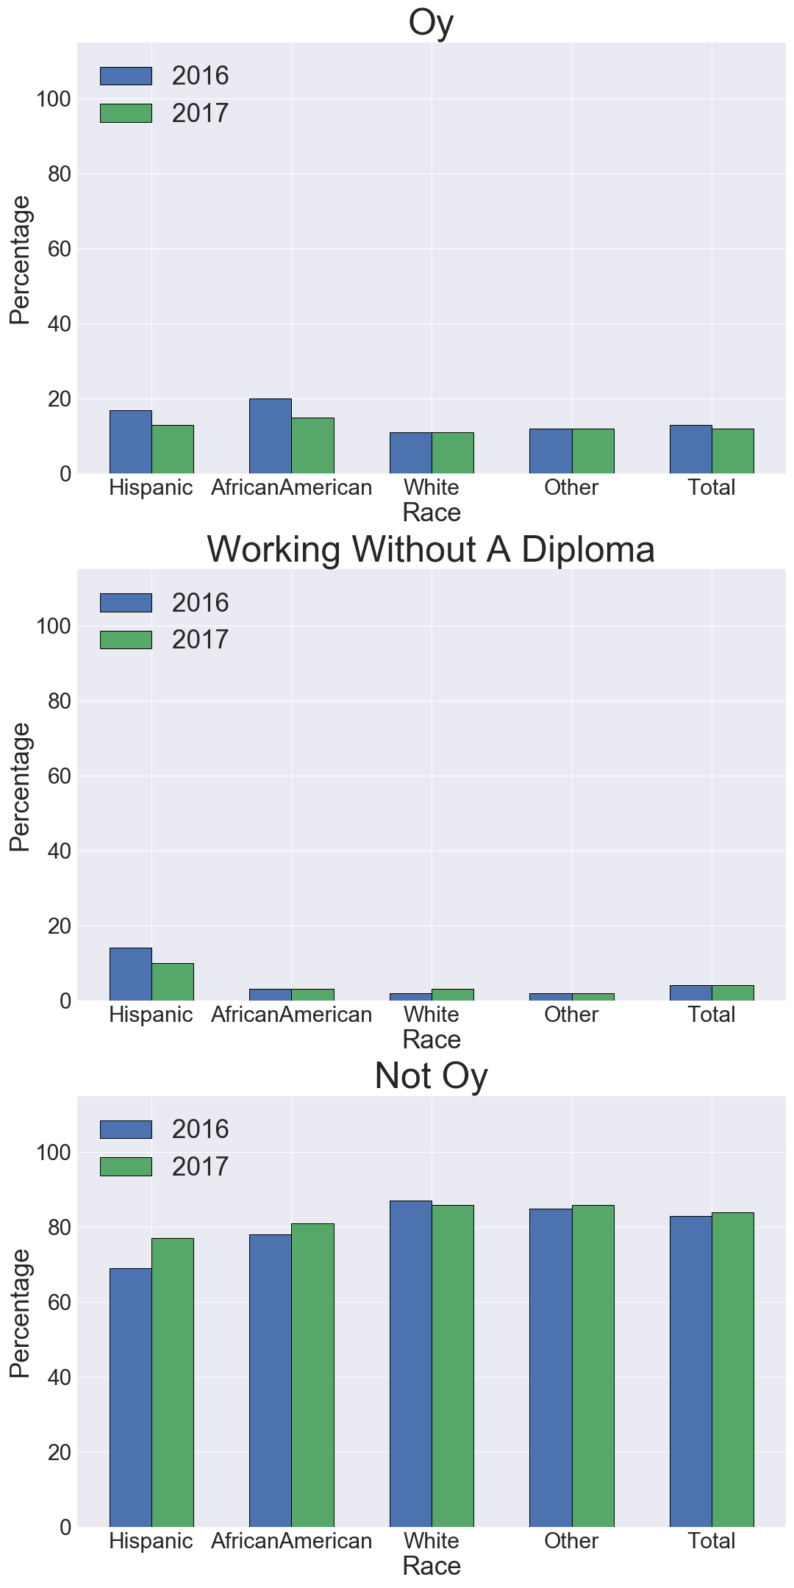
Ethnicity Desprity
Both of these Ethnic Groups have a increase of people seeking higher education Jobs.
Hispanics and African americans have the greatest decrease in OY.

Slide 11
Limitations
The parameters for categorization was subjective.
Inconsistent with 2016 calculations

Slide 12

Where We Would Like to Go From Here
With further research we would like to discover:
How South King County stands Compared to the rest of King County?
In the industries these young workers are going into what kind of positions are they attaining?
Are they going to Technical Schools?
Has minimum wage affected their decision to join the workforce after high school?

Slide 13
Citations
US Census Bureau. “TIGER/Line Shapefiles.” The United States Census Bureau, 6 May 2019, www.census.gov/geographies/mapping-files/time-series/geo/tiger-line-file.2017.html.
Belfield, Levin, Rosen. “The Economic Value of Opportunity Youth”, January 2012, https://www.americaspromise.org/sites/default/files/d8/legacy/bodyfiles/Econ_Value_Youth_Jan_11_2012.pdf.

Slide 14
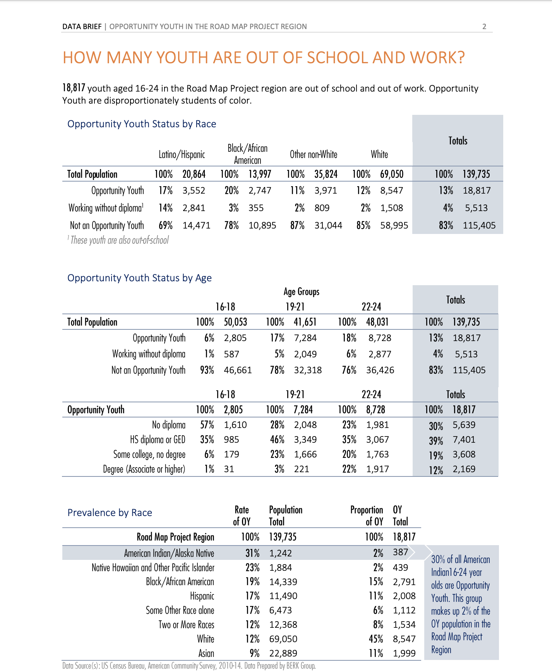
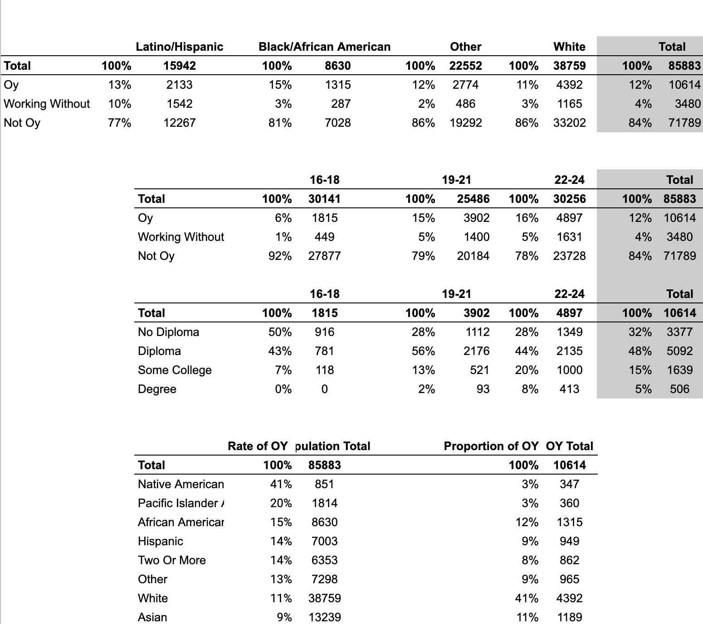
Full Comparison

